Slide 1

Stage 6 Willy-Nilly Course Designer: Ken Wang
Willy-Nilly is a 18 round, 90 point, COMSTOCK Medium course. There are 8 USPSA targets and 2 steel targets. The best 2 hits per target will score. Steel must fall to score. The start signal is audible.
The handgun start position is standing with hands touching upper marks. Handgun is loaded and holstered. PCC start position is stock on belt, safety on, muzzle touching the lower mark.
On the audible start signal, engage all targets from within the shooting areas. P1 activates DT1, which is not visible at rest. The designated wall (most uprange one) does not extend to the ground.

Slide 2
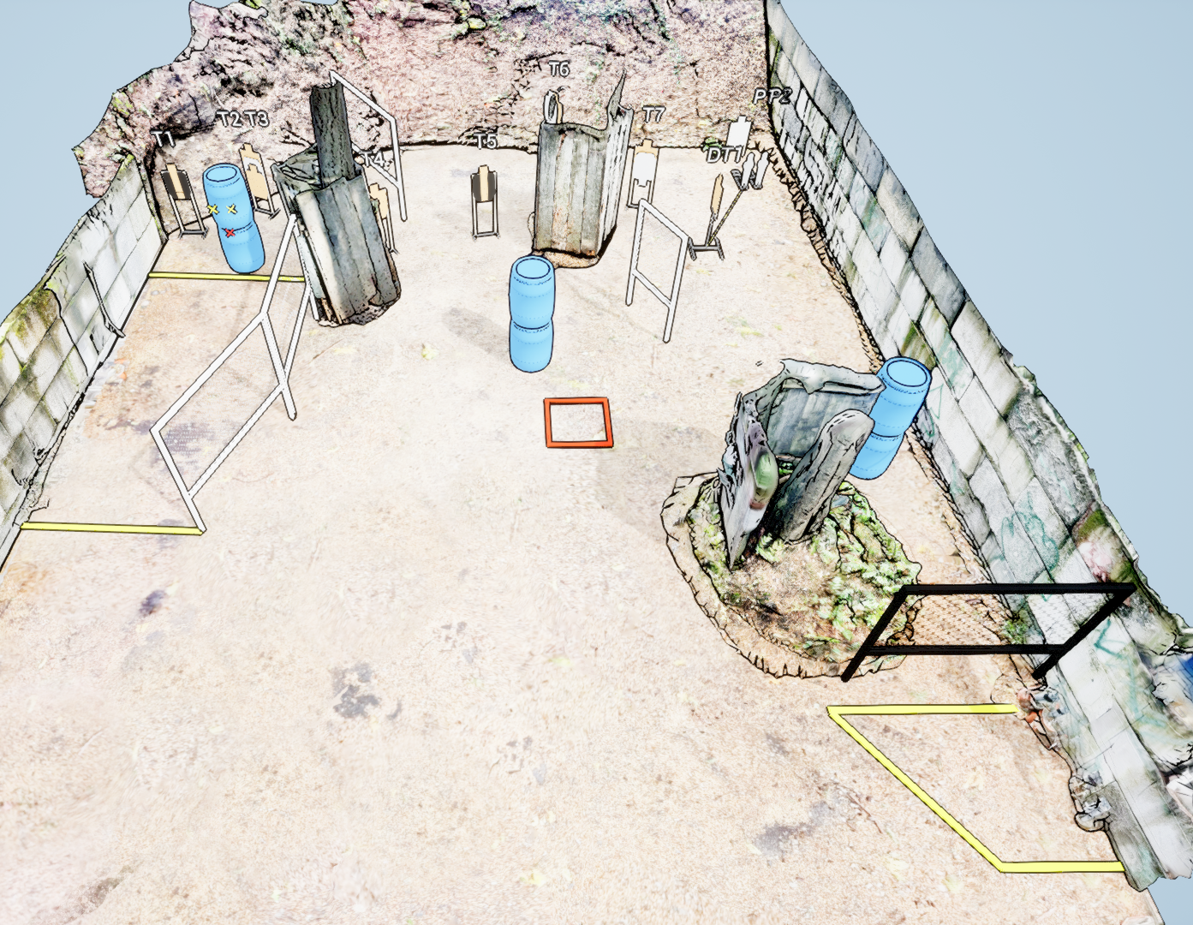
 | Stage 6 Willy-Nilly Course Designer: Ken Wang

